Slide 1
Real Time drowsiness detection system for safe driving
CECS – 553 MACHINE VISION
PROJECT PRESENTATION
Smith Elias Dabreo
Kalyan Reddy
Sai Raj Reddy Dyapa
Mentored by Dr. Benyamin Ahmadnia

Slide 2
AGENDA
Background
Problem Statement
​Existing Systems and Limitations
Novelty of our system
Proposed Solution
Dataset
Preprocessing the Data
Building the Model
Model Results
Model Implementation
Futurework
Conclusion

Slide 3
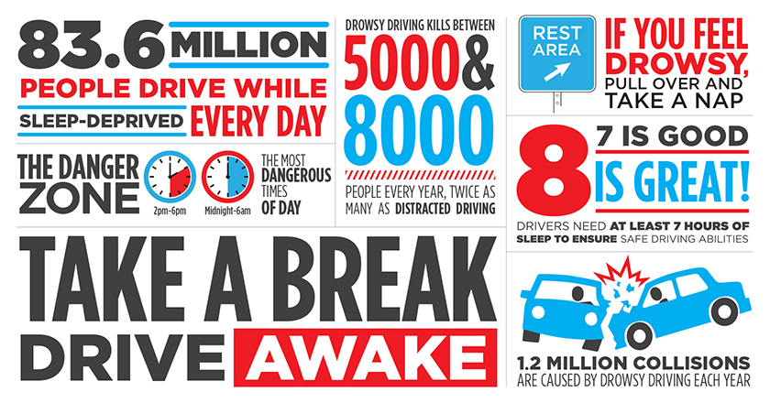
Background

Slide 4
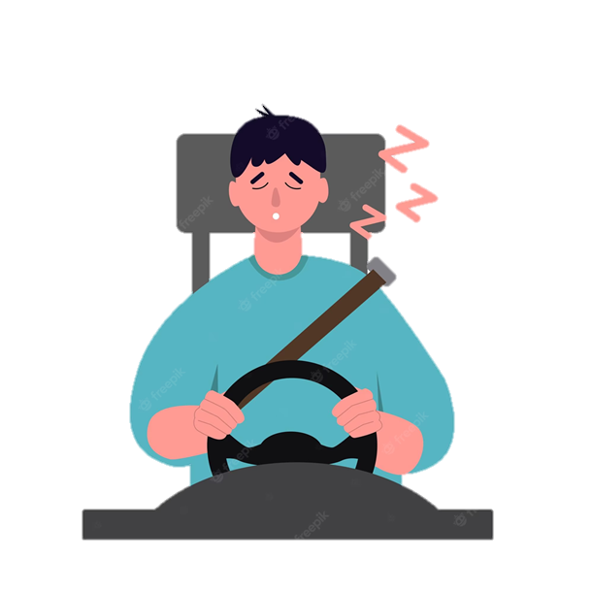
Problem statement
Drowsy Driving is a dangerous combo of driving and being sleepy. The frequency of traffic accidents caused by drowsy driving is rising at an alarming rate around the world. The biggest cause of tiredness while driving is a lack of sleep and fatigue. Other factors, such as sleep difficulties, medication, alcohol usage, or driving during night shifts, can also contribute to tiredness while driving. This project aims to solve this problem by taking advantage of Machine Vision.

Slide 5
Existing Systems
Lane departure warning systems: This system uses cameras or sensors to monitor the vehicle's position on the road and alerts the driver if they begin to drift out of their lane.
Fatigue monitoring systems: This system tracks the driver's steering patterns and alerts them if it detects that they are becoming erratic or inconsistent, which could indicate drowsiness.
Automatic emergency braking systems: After detecting a drowsy driver the system automatically drives the vehicle to safety and stops.
Wearable Devices: There are also wearable devices that can monitor the driver's heart rate, brain activity, or movements, and alert them if it detects signs of drowsiness.

Slide 6
Limitations
False alarms in some
Higher Cost
Reliance on driver response
Limited effectiveness
Notes:
False alarms - Some systems may issue alerts or warnings when the driver is not actually fatigued, such as when the sensors are unable to accurately detect the driver's state or if the road conditions are challenging. Cost - Some driver sleepiness prevention systems can be expensive to install or maintain, which may limit their availability or adoption. Reliance on driver response - Some systems rely on the driver to take action in response to an alert or warning, which may not always be effective if the driver is too fatigued or distracted. Limited effectiveness - Some systems may not be effective for all drivers or in all situations, such as if the driver is under the influence of drugs or alcohol or if the road conditions are hazardous.

Slide 7
Novelty of our system
While existing solutions include a range of monitoring systems, such as steering wheel monitoring and biosensor-based belts, our proposed model takes a different approach. Specifically, it utilizes facial landmark detection to identify the driver's face and analyze their eye regions using an eye blink classifier powered by deep learning.
By monitoring the driver's eye movements and distinguishing between open and closed eyes, the model can accurately detect signs of drowsiness. To alert the driver, the alarm module tracks the driver's blink rate and triggers an alarm when it reaches a predetermined threshold. This allows the driver to take corrective action and avoid potential accidents.

Slide 8
Proposed solution
Mount a web camera in an appropriate position to capture live footage of the driver's face.
Feed the video input into a face detection module to identify the driver's face.
Isolate the driver's face as a region of the video frame.
Use a Facial Landmarks Detection classifier to detect the location of the driver's eyes.
Apply an eye blink classifier, which is powered by a deep learning model, to determine if the driver's eyes are open or closed.
Use an alarm module to track the length of blinks and alert the driver if the duration of a blink exceeds a predetermined threshold.

Slide 9
Dataset
The MRL Eye Dataset which is readily available on the internet was utilized.
This dataset is extensive and comprises human eye images.
It includes both low and high-resolution infrared images, all captured in various lightning conditions and by different devices.
The dataset is publicly accessible.
It contains 84,948 images of open and closed eyes captured from 37 different individuals.
The images are categorized into various groups, which also makes them appropriate for training and testing classifiers.

Slide 10
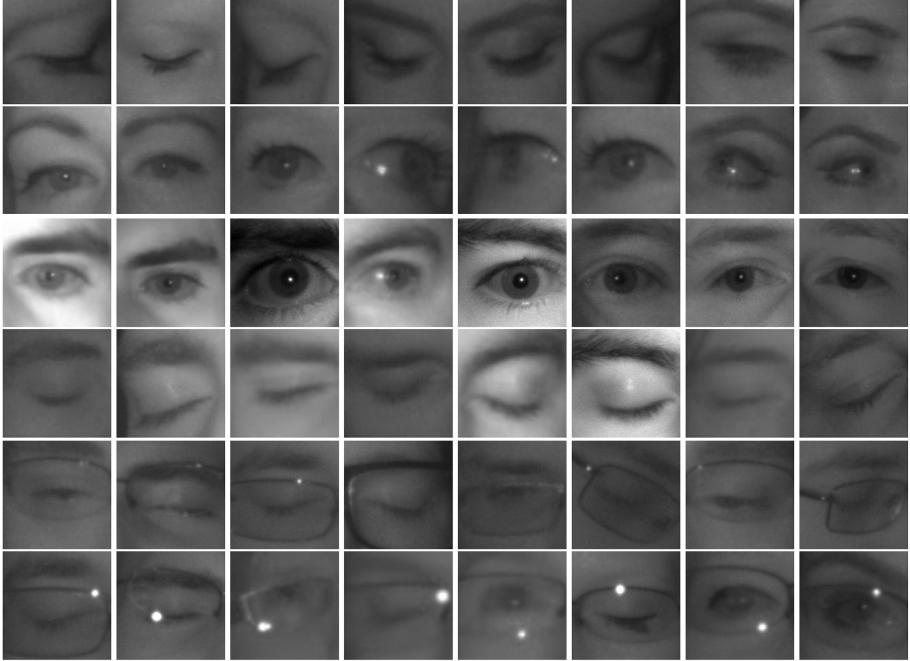
DATASET

Slide 11
Preprocessing the data
• The dataset has annotations such as SubjectID, ImageID, Gender, Glasses, Eye state, reflections, lighting conditions, and Sensor ID.
• The dataset was available in 37 different folders, each containing images of one of the 37 subjects.
• The images were filtered based on lighting conditions, reflections, Sensor ID, and eye state.
• After filtering, there were around 15,000 images of open and closed eyes.
• We created an automated script to annotate the images into two classes - open eyes and closed eyes - and sorted them into separate folders.
• A split was applied to the dataset with a 90-10 ratio for training and testing.
• The training set contained around 27,000 images.
• The test set contained around 3,000 images.

Slide 12
Building the Model
We used the ImageDataGenerator from Keras to create real image augmentations like zoom range, rotation, and height shift range.
The training set was split into an 80-20 ratio for validation, resulting in three separate datasets - train, test, and validation.
We used transfer learning in our model.
Transfer learning is a method of utilizing feature representations from an existing pre-trained model, saving time and reducing generalization errors.
Set the base model as InceptionV3 with imagenet weights.
We removed the top layer of the base model (classification layer) and froze all other layers in the base model.

Slide 13
Inception v3 Model
InceptionV3 is a neural network model developed by Google and originally introduced during the ImageNet Recognition Challenge. It belongs to the CNN family of models.
InceptionV3 consists of symmetric and asymmetric building blocks that include convolutions, pooling, concatenations, dropouts, and fully connected layers. The model uses batch normalization extensively, and it's applied to activation inputs.
Softmax and relu units were added to the new model and then trained.
Used Model checkpoints to save the best model based on loss metric and Keras Callbacks API’s EarlyStopping and ReduceLROnPlateau to avoid over fitting and modify learning rate during training.
The model was trained with a batch size of 8.
The training was conducted for 30 epochs.

Slide 14
Model Results
Training set
Accuracy: 93.8977
Loss : 0.1568
Test set
Accuracy: 90.5021
Loss : 0.1471
Validation set
Accuracy: 91.8203
Loss : 0.1726

Slide 15
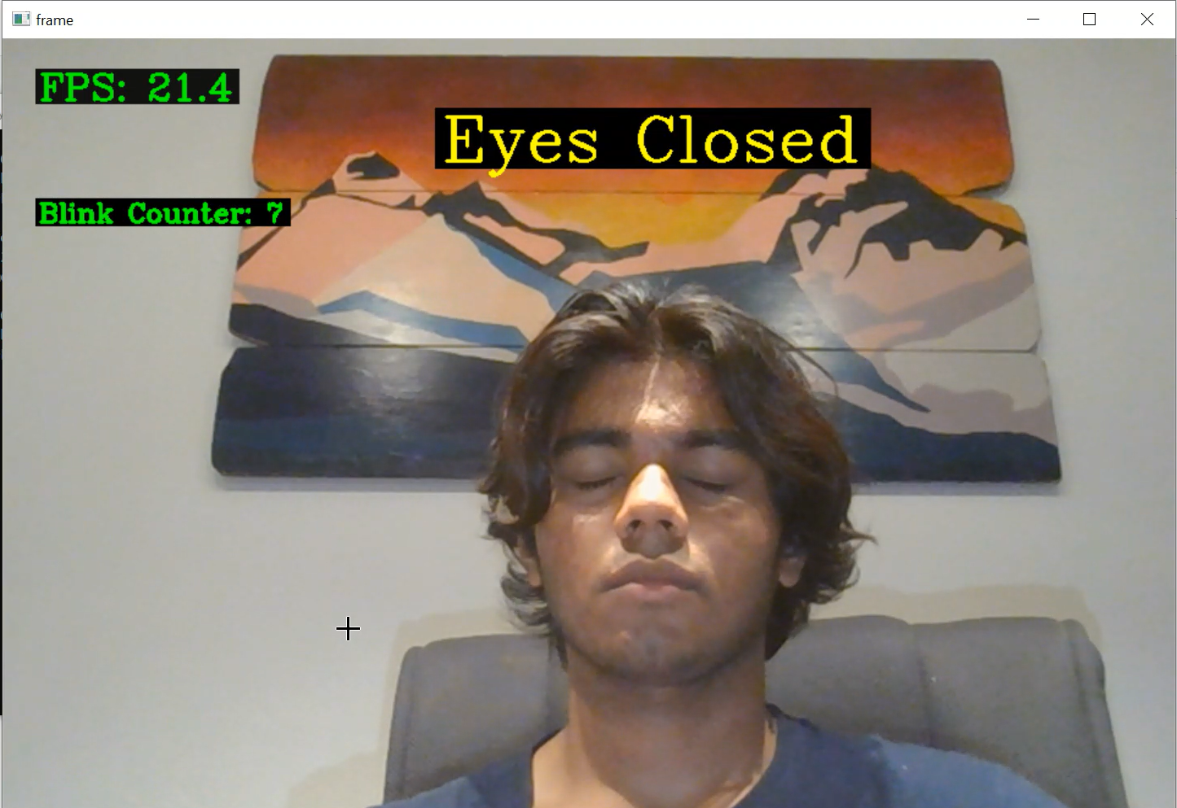
Model Implementation

Slide 16
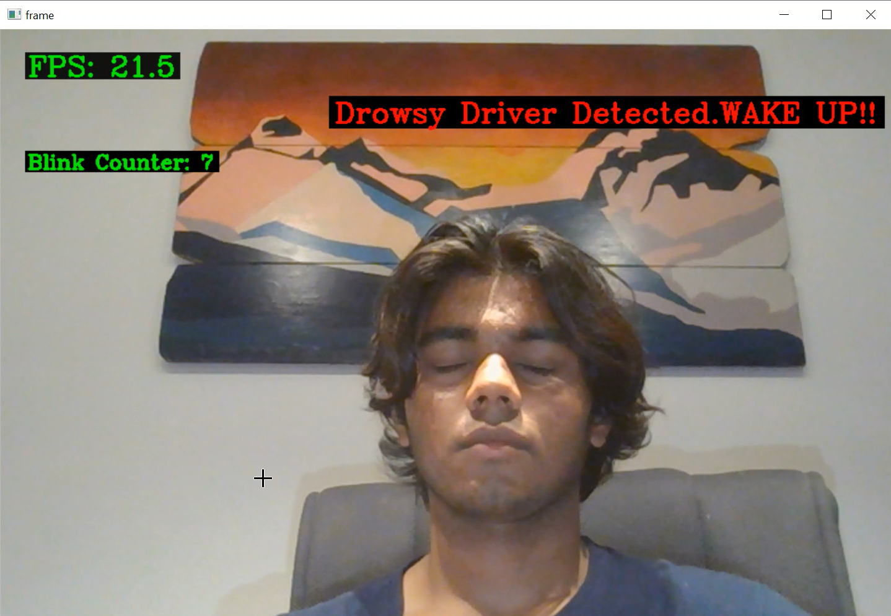
Model Implementation

Slide 17
Futurework
Enhance the drowsy driver detection model by incorporating a broader range of open and closed eye images from individuals representing diverse ethnicities.
Create a dedicated hardware module that integrates a camera, designed to be mounted within vehicles to enhance accuracy of the drowsy driver detection system.
Instead of relying solely on sound alarms, consider expanding the range of actions that can be taken after a drowsy driver is identified, such as reducing the vehicle's speed, issuing visual or tactile alerts, or recommending that the driver take a break.
Utilize the installed camera module for multiple purposes, including driver facial recognition and capturing footage in the event of an accident.

Slide 18
Conclusion
Notes:
Drowsiness detection in drivers is crucial for ensuring both personal and public safety. The increasing usage of artificial intelligence can be very helpful in anticipating a driver's level of weariness. It has various advantages, as the installation of a camera is simple, and it does not hinder the driver’s experience or comfort like other techniques such as biological features or vehicle-based features. Not prone to external disturbances, considers only the driver’s face. Overall, Real-Time Drowsiness Detection System for Safe Driving Project represents a significant step forward in road safety technology and has the potential to save lives and reduce the cost of road accidents.

Slide 19
THANK YOU

